Slide 1
AI Based Web scraping and Knowledge Graph

Slide 2
Start
Convert Raw Data to sentences and store in CSV file
Import Python Libraries
Extract SOV from Sentences
Read List of URL’s and filter parameter from Resources.xlsx
Filter out desired relationships
Request Site
Display data in graphical format
Extract Data Elements from Response
Stop
Create Text File to hold response data

Slide 3
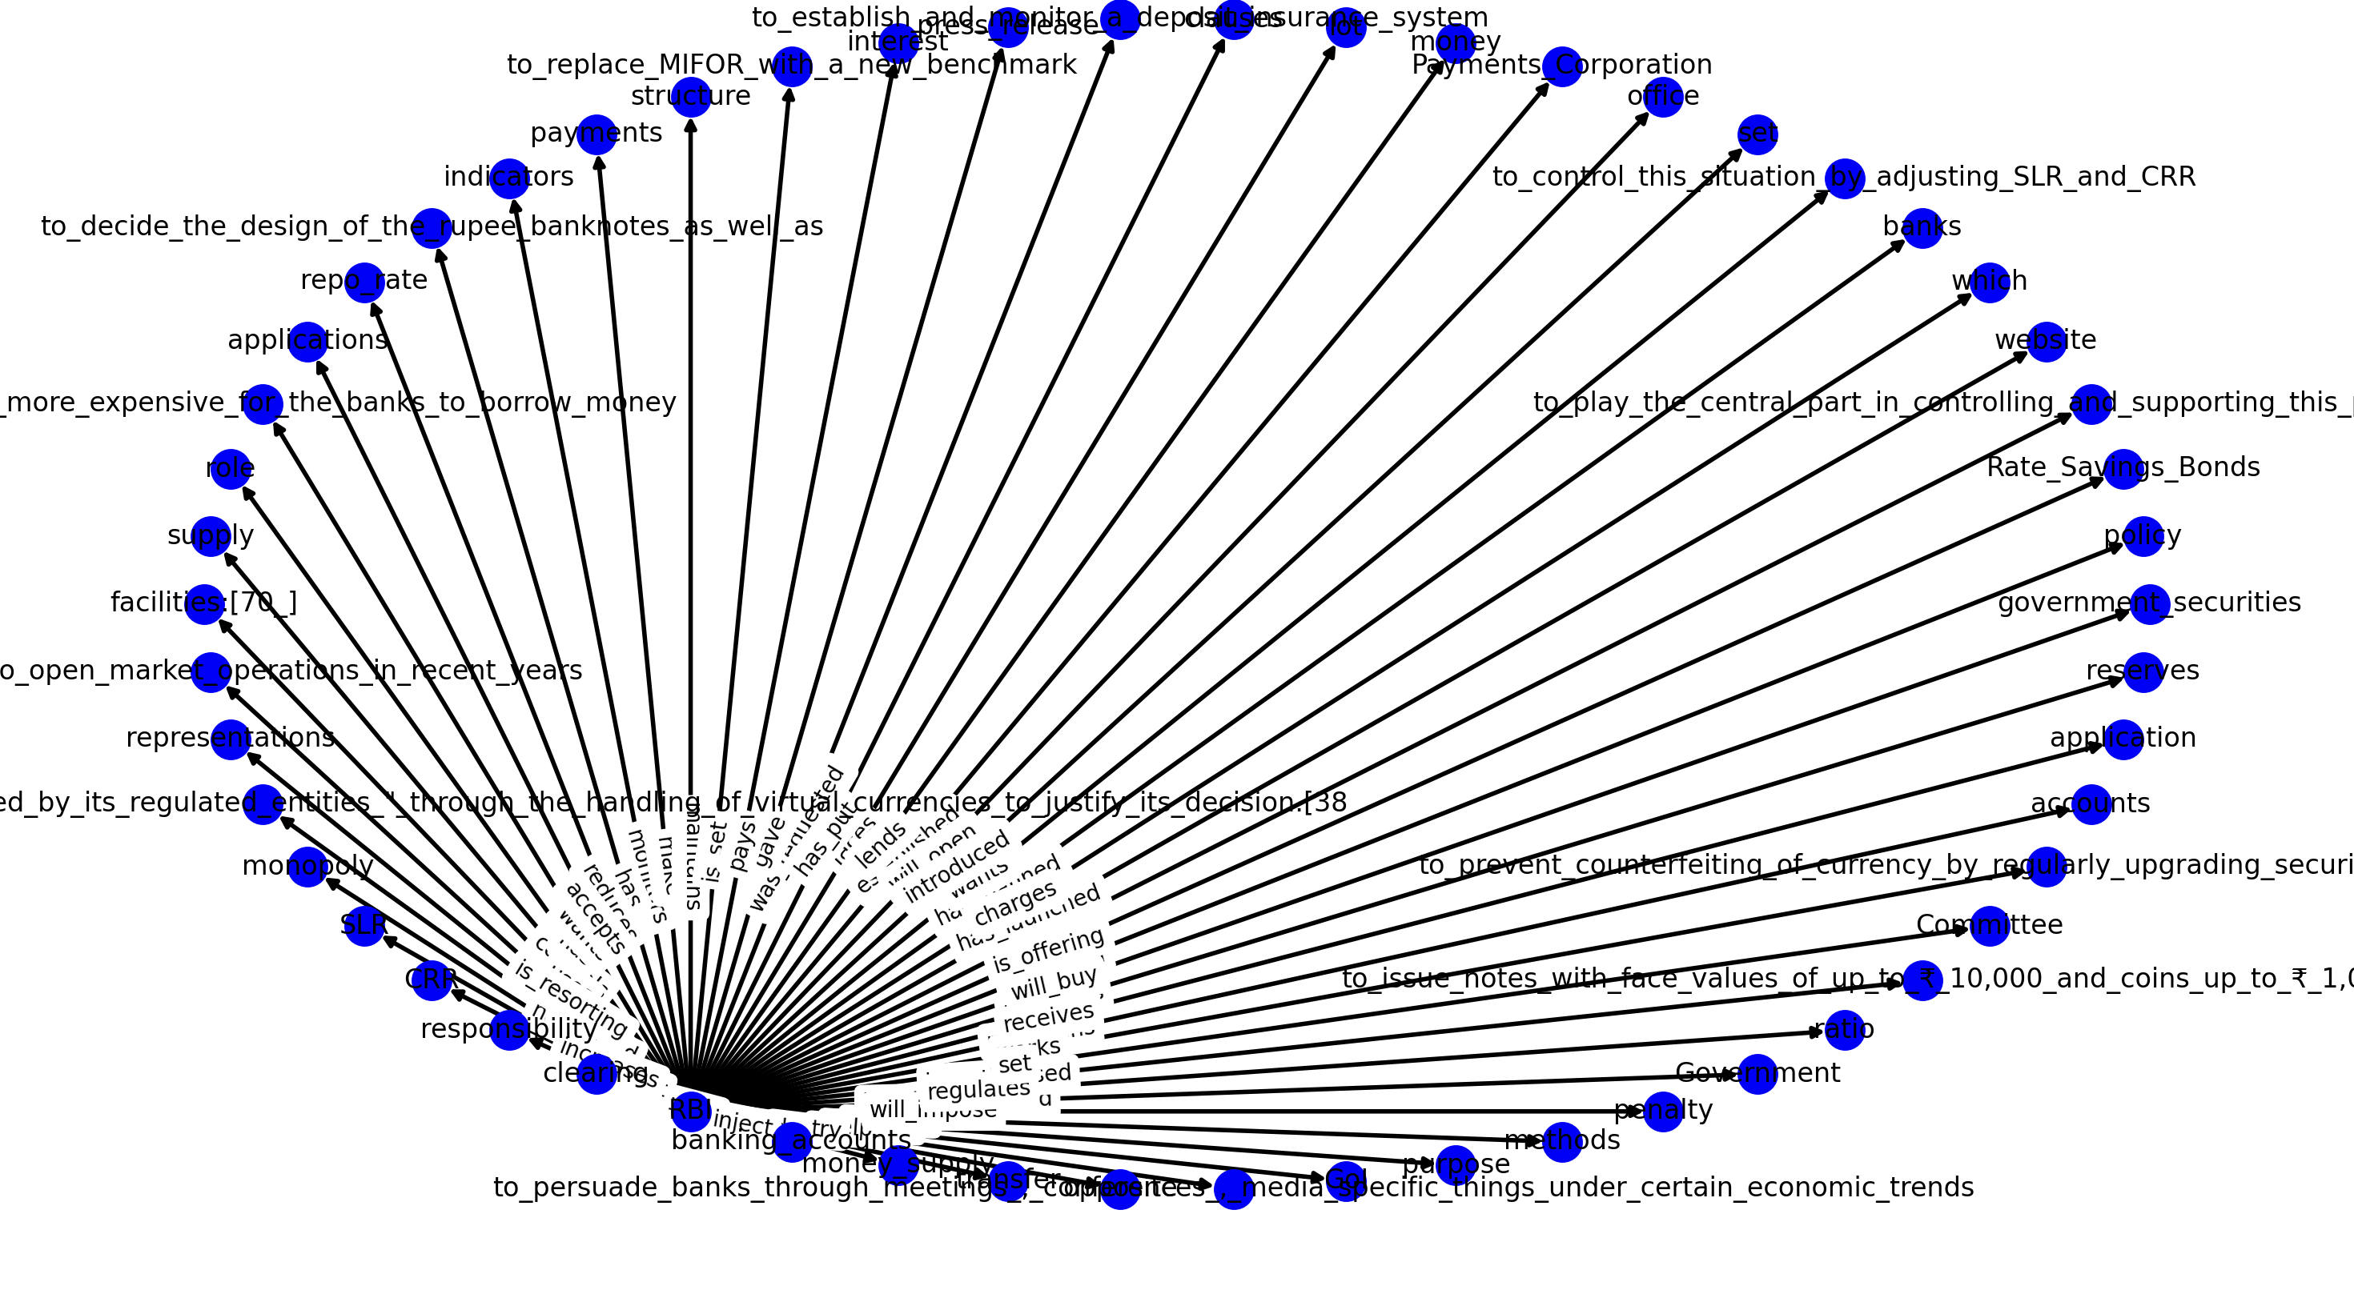
Sample Knowledge Graph Output

